Slide 1
PRESENTATION TITLE
Title: "Revolutionizing Home Loan Assessments: Instant Creditworthiness Prediction using Machine Learning"
Date: 21.08.2023

Slide 2
TEXT LAYOUT 1
Project Overview
Business Problem: Standard Bank's manual home loan assessment process is time-consuming, causing delays in loan decisions. The challenge is to speed up assessments while ensuring accurate credit risk evaluations.
Business Objective: Our goal is to develop a machine learning model that predicts loan applicant creditworthiness accurately. This will enable instant loan decisions, improving customer satisfaction and keeping the bank competitive.
Hypothesis: We predict that leveraging a well-trained machine learning model can accurately determine if a loan applicant is likely to default. By considering factors like gender, marital status, income, and credit history, we aim to expedite assessments while maintaining accuracy compared to manual evaluations.

Slide 3
TEXT LAYOUT 1
Data
Describe Data
The dataset provided for this project contains information about loan applicants and their attributes. These attributes play a crucial role in predicting creditworthiness. Here's a brief overview of the columns in the dataset:
Loan_ID: A unique identifier for each loan applicant.
Gender: The gender of the applicant (e.g., Male, Female).
Married: Marital status of the applicant (e.g., Married, Single).
Dependents: Number of dependents of the applicant.
Education: Educational background of the applicant (e.g., Graduate, Not Graduate).
Self_Employed: Whether the applicant is self-employed (Yes or No).
ApplicantIncome: Income of the applicant.
CoapplicantIncome: Income of the coapplicant (if applicable).
LoanAmount: The amount of the loan applied for.
Loan_Amount_Term: The term of the loan in months.
Credit_History: Credit history of the applicant (1: Good, 0: Bad).
Property_Area: Area type of the property (e.g., Urban, Rural, Semiurban).
Loan_Status: Whether the loan was approved or not (Y: Yes, N: No).

Slide 4
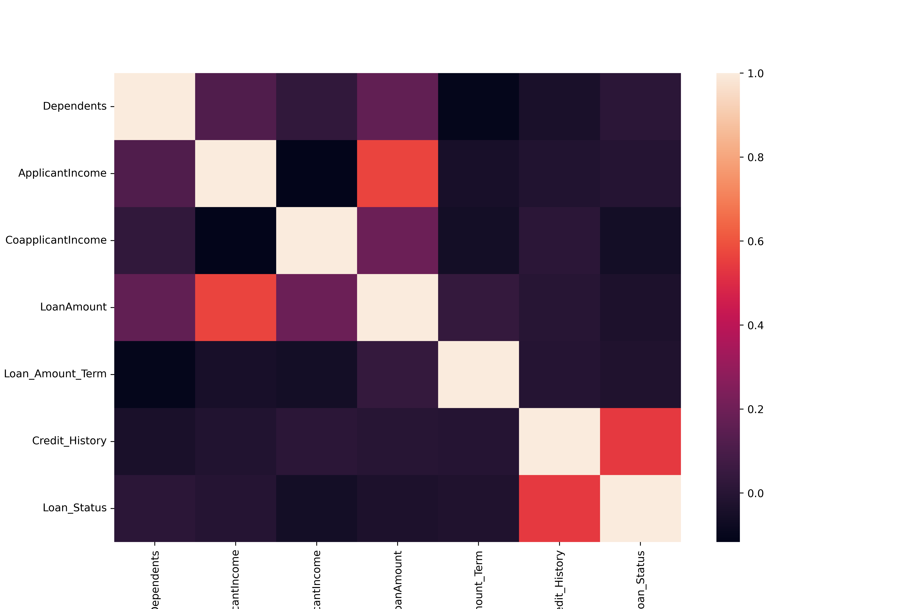
TEXT LAYUT 1
Correlation Heatmap

Slide 5
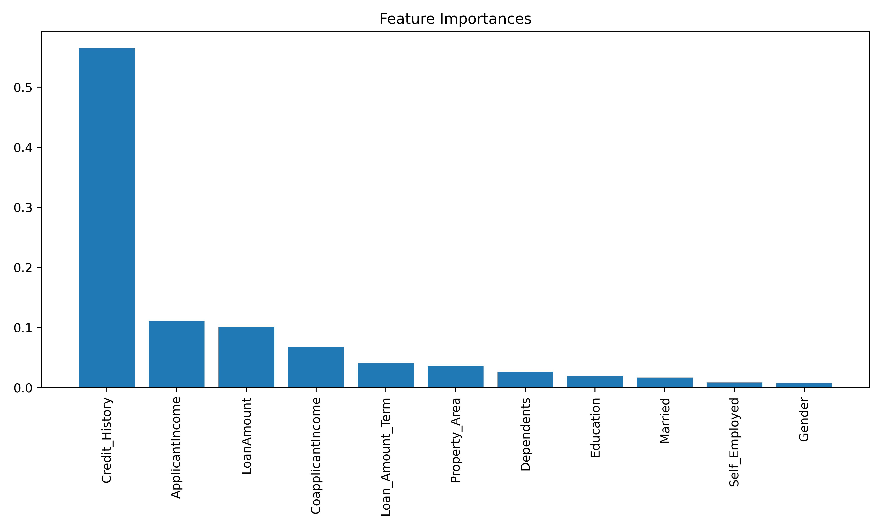
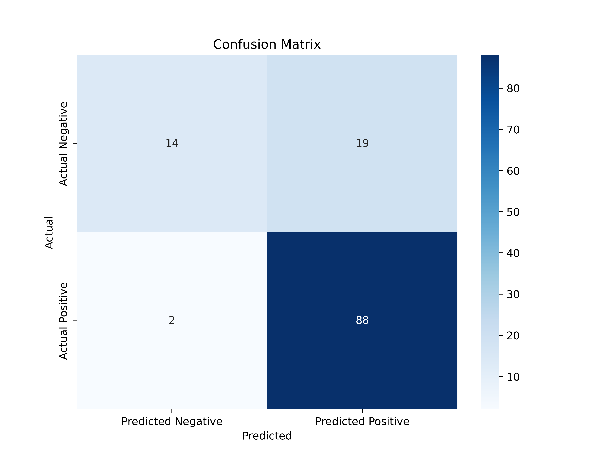
TEXT LAYOUT 1
Modeling
Random Forest Classifier
max_depth=5, max_features='sqrt', n_estimators=200
Train accuracy of the model : 0.81
Train accuracy of the model : 0.82

Slide 6
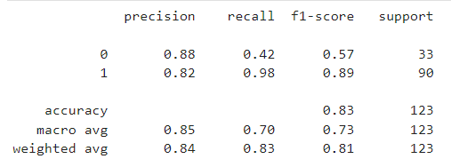
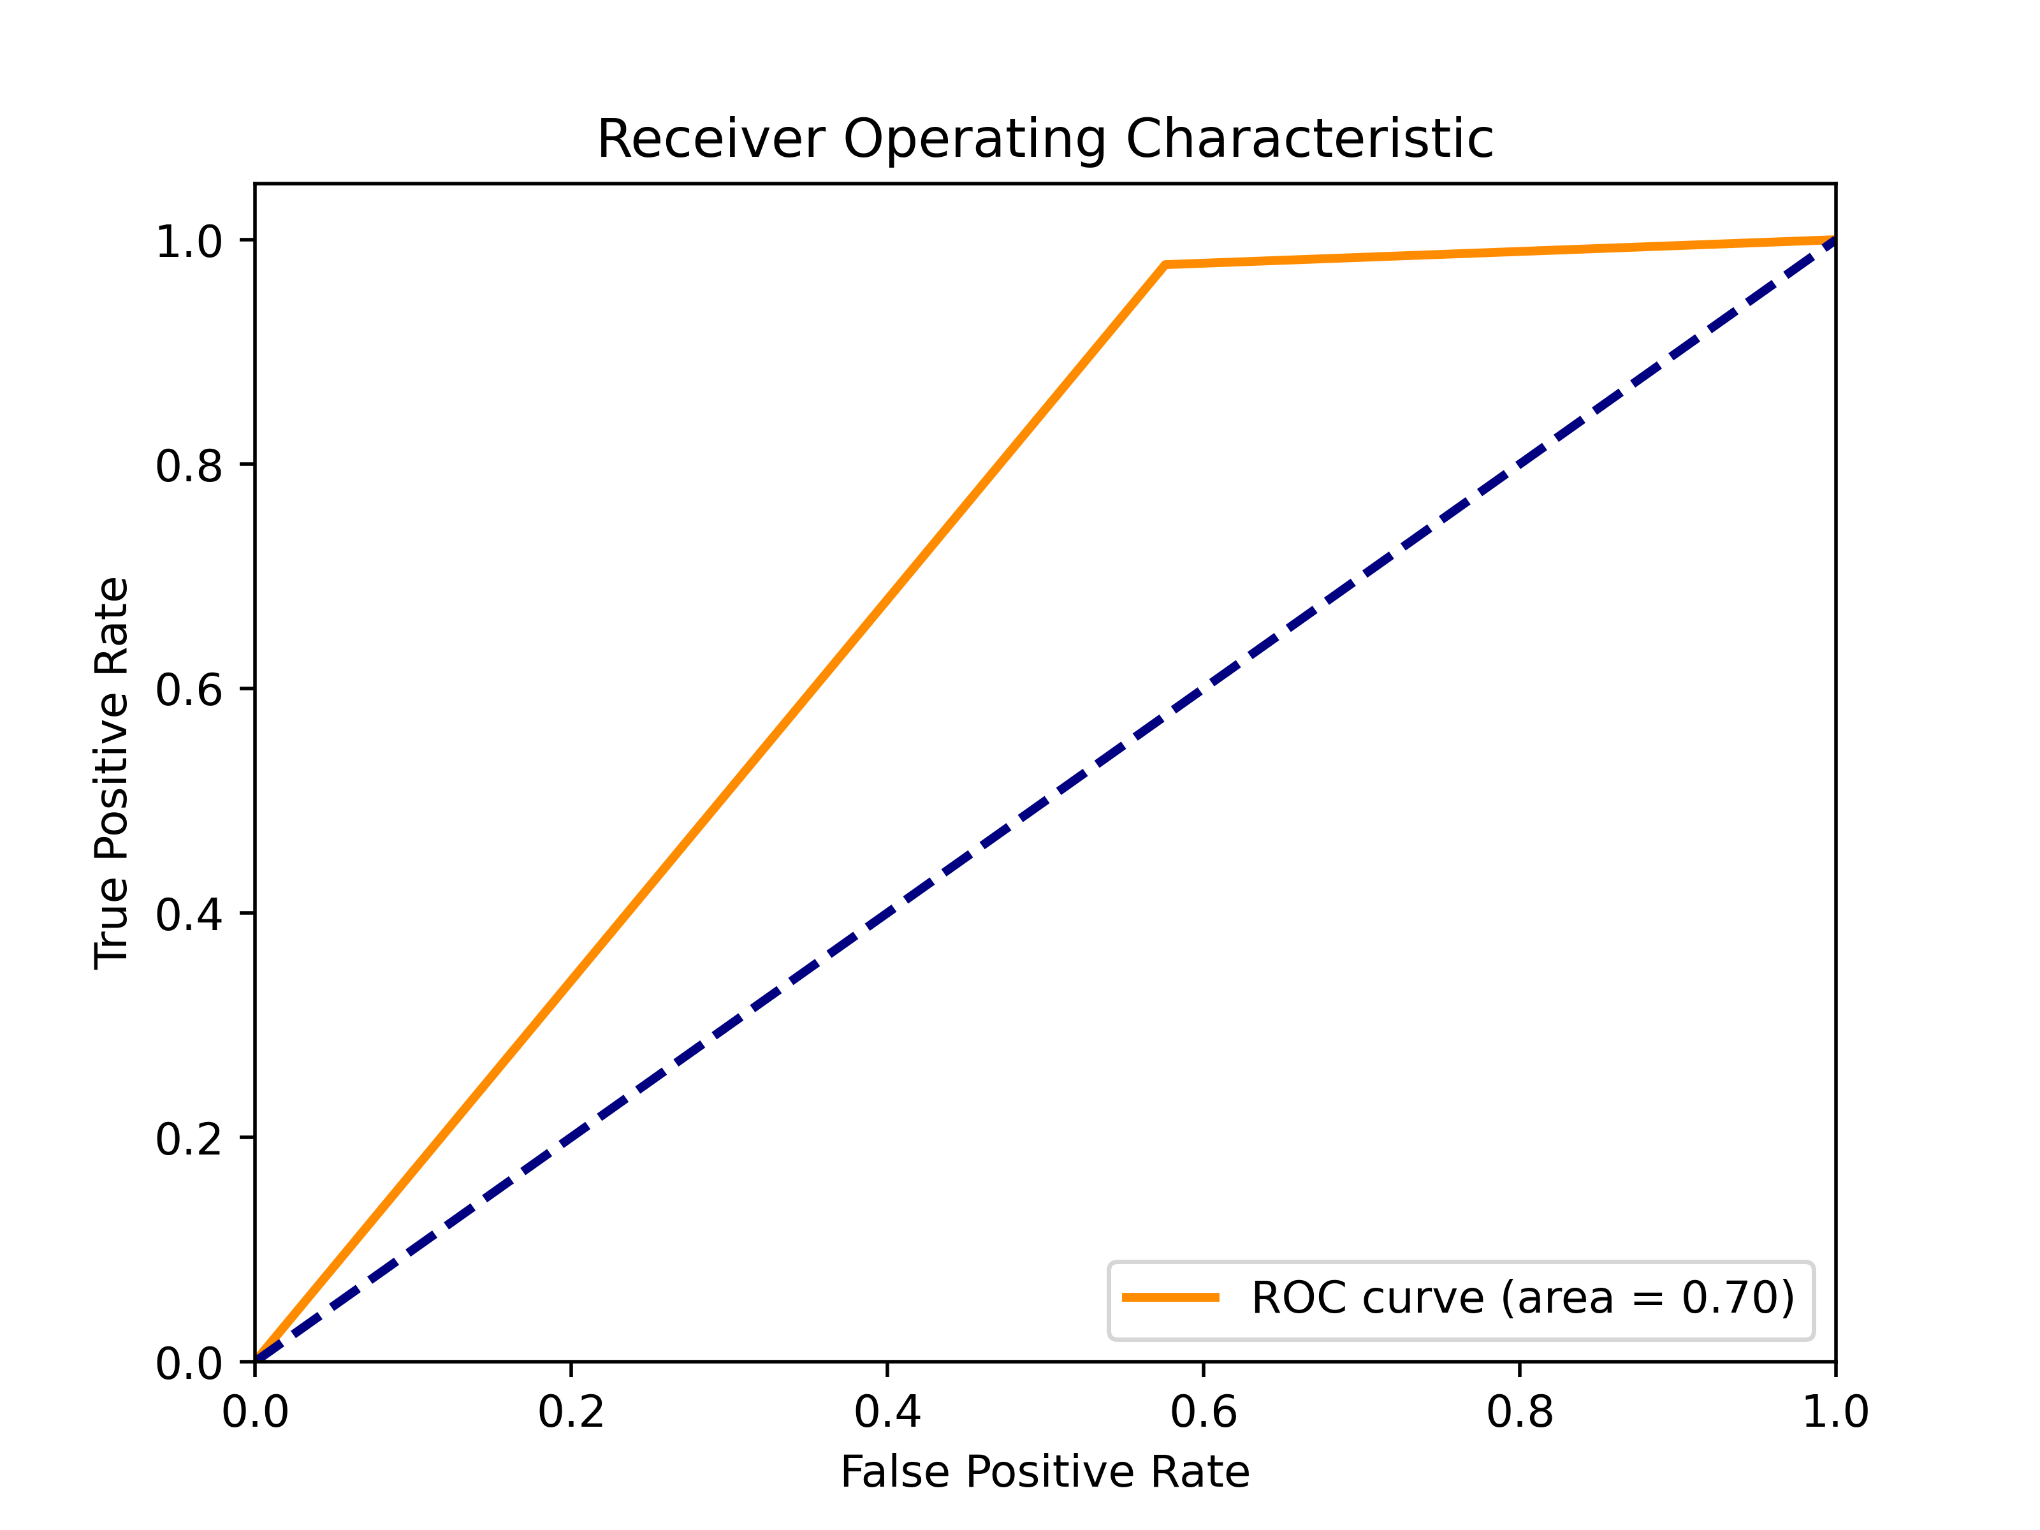
TEXT LAYOUT 1
Model Evaluation

Slide 7
TEXT LAYOUT 1
Recommendations
Data Augmentation:
If feasible, consider generating synthetic data to supplement the training set, which might help improve the model's ability to generalize.
Regular Monitoring and Updates:
Continuously monitor the model's performance in a real-world setting and iterate on improvements based on feedback and observed outcomes.
Further Data Collection:
If possible, gather more data, especially on defaulting applicants, to better capture the underlying patterns and behaviors.

